Slide 1
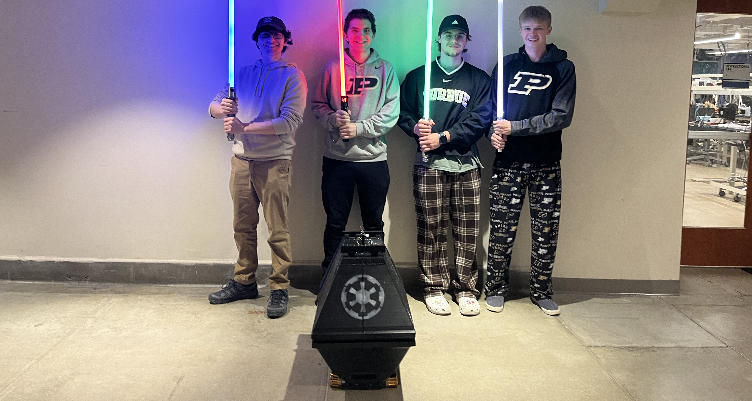
ECE 477 Final Review: Team #2

Slide 2
Outline
Project Overview
Block Diagram
Design Challenges
Individual Contributions
Project Video Demonstration
Questions

Slide 3
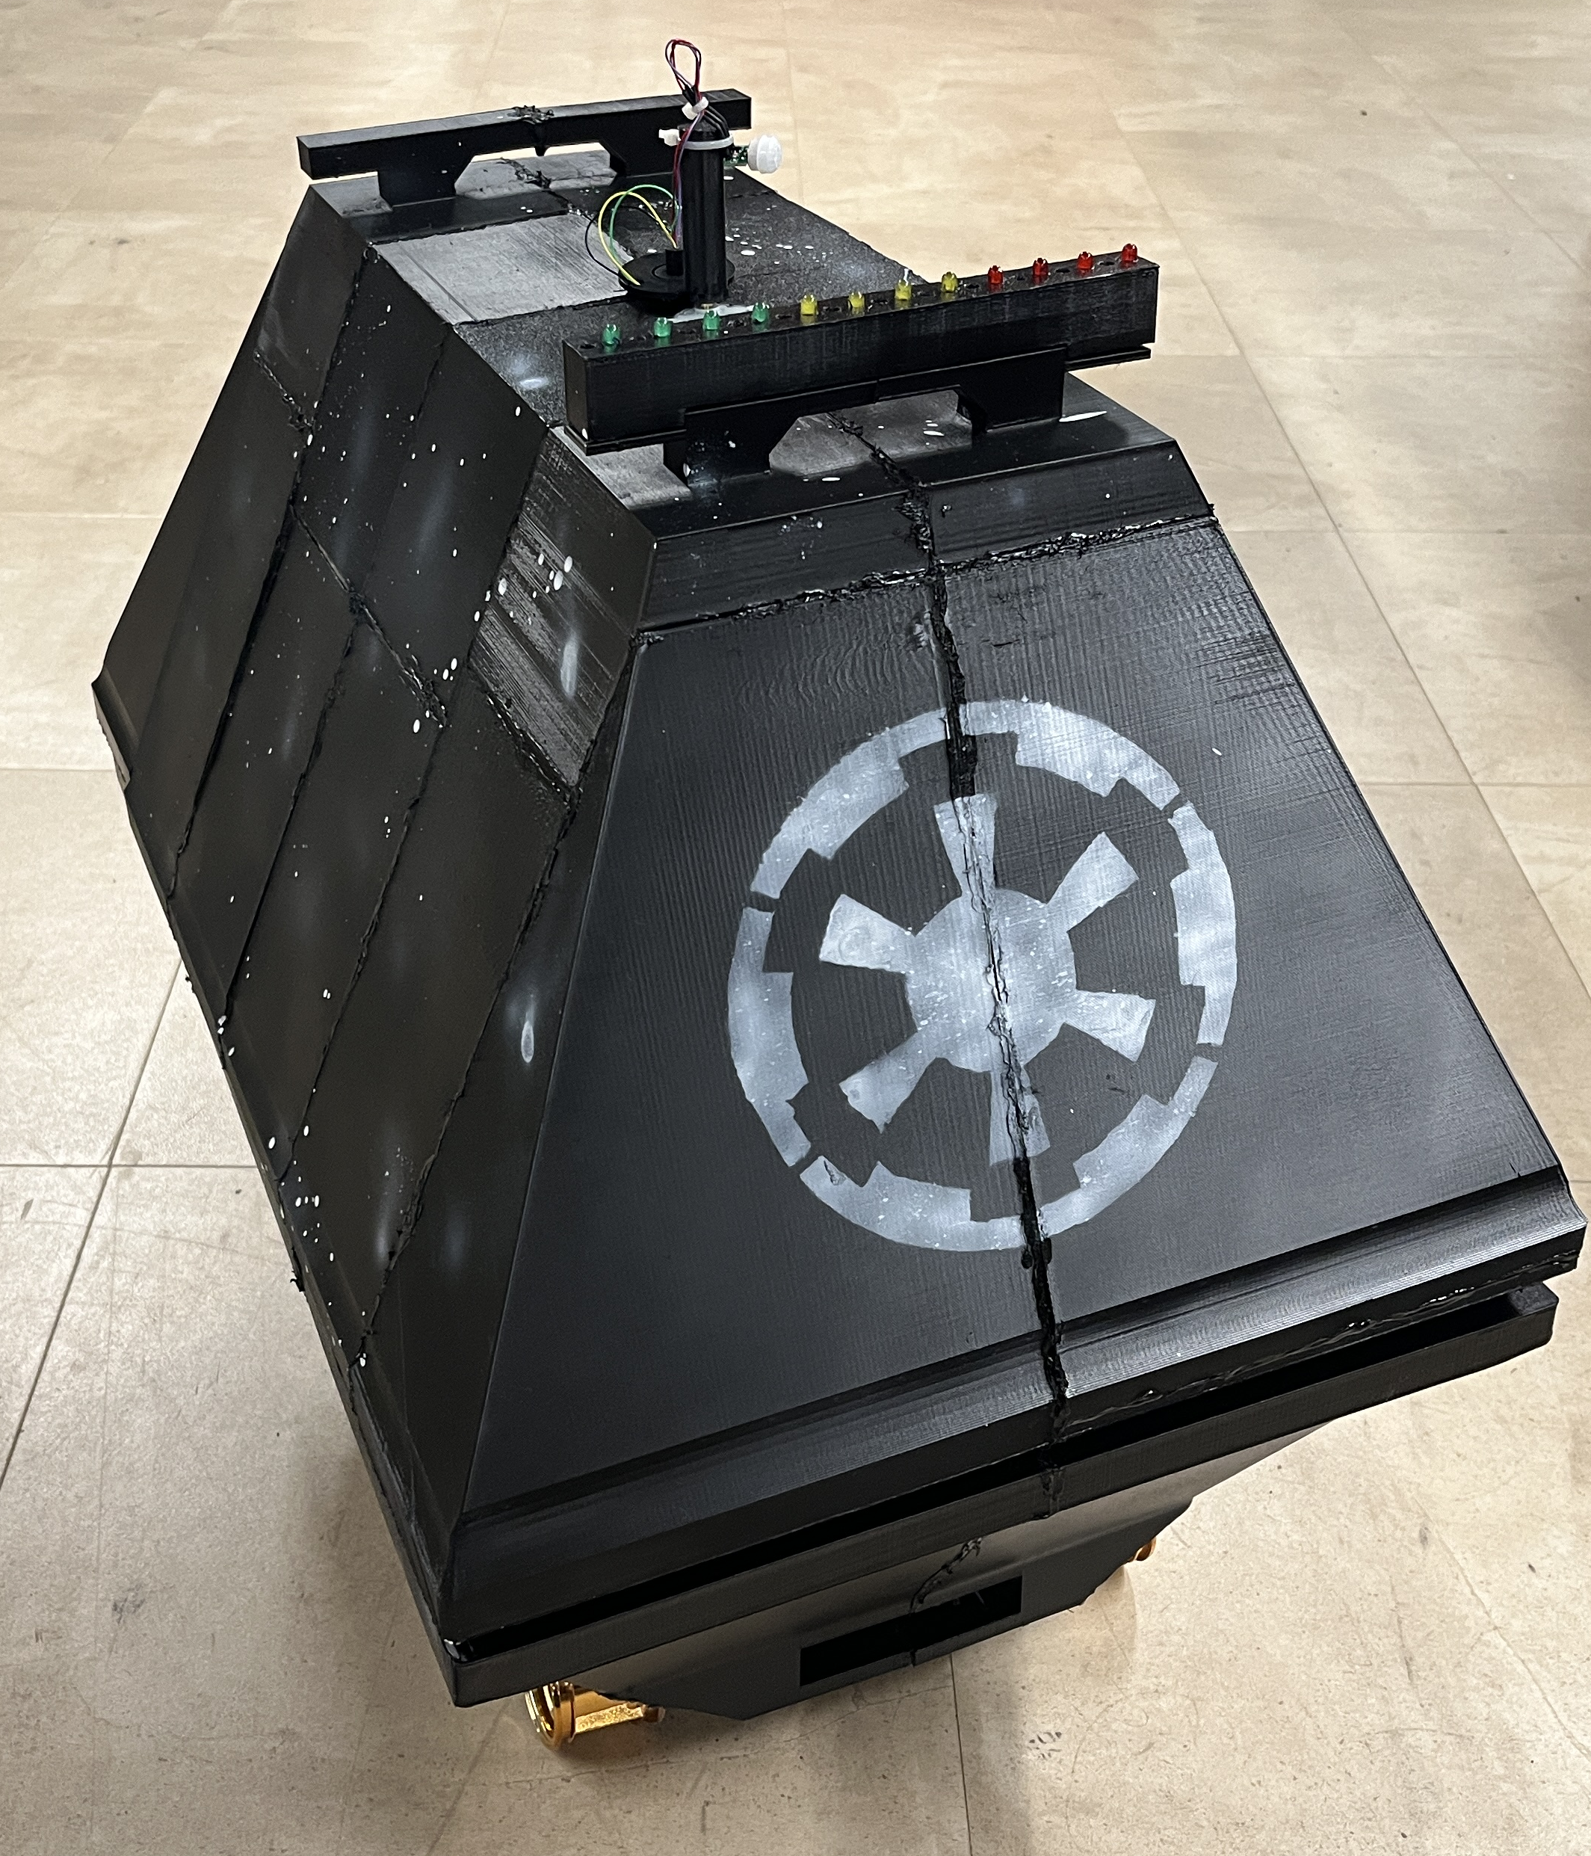
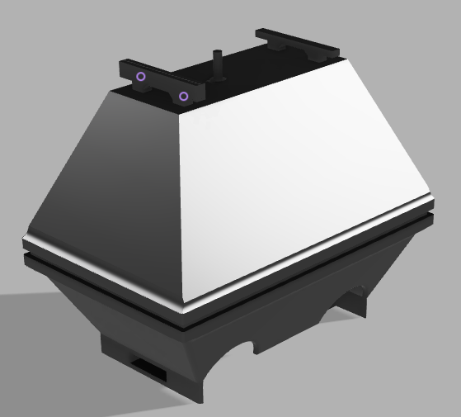
Project Overview
MOUSE is a mobile surveillance robot intended for indoor use, in corporate office or residential environments.
An 18V battery with an external buck converter allows MOUSE to perform surveillance overnight without needing to have its battery replaced.
Movement is powered by four motors, each controlling its own wheel. MOUSE has variable speed control from PWM signals.
Notes:
Need to add good orthogonal view of actual MOUSE with wall as backdrop

Slide 4
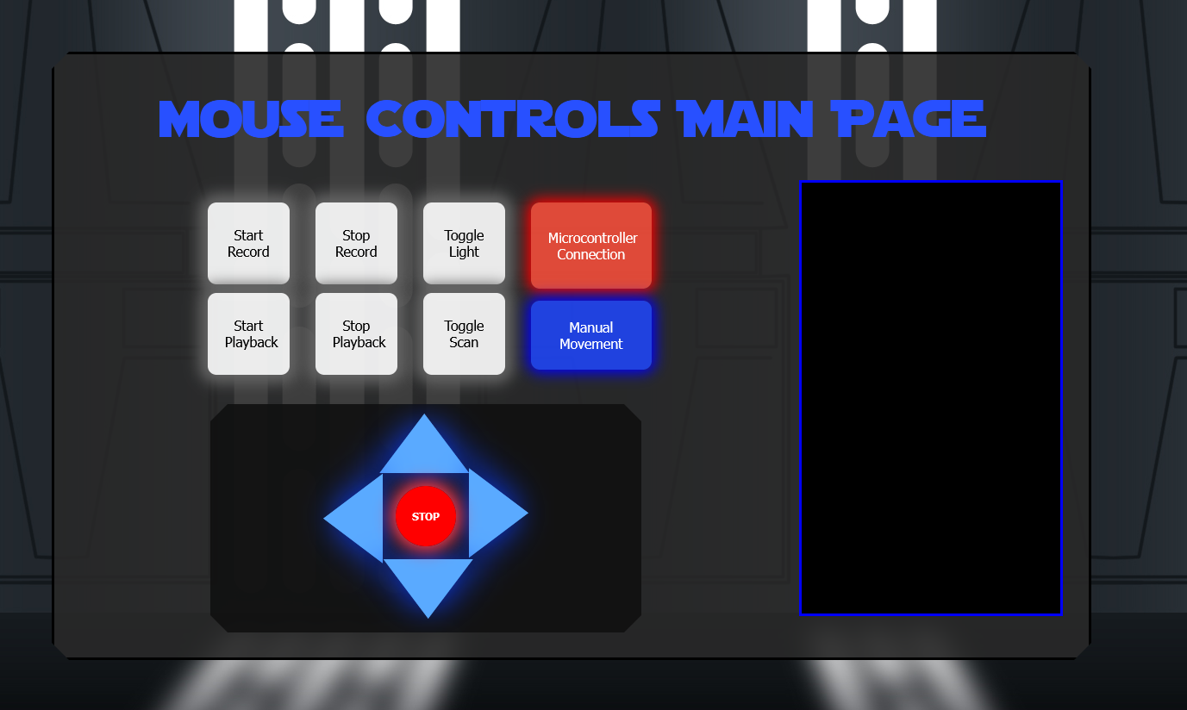
Project Overview
User-friendly UI on a webpage to use MOUSE movement controls and display if any objects have been detected with timestamps.
MOUSE and the web interface send data wirelessly through WiFi via a web server.
MOUSE can detect movement in all directions with a PIR sensor mounted on a stepper motor.
Notes:
In this section provide a concise description of your project. What is it? What does it do? Include a relevant picture of your project or “artist rendering” of the completed project.

Slide 5
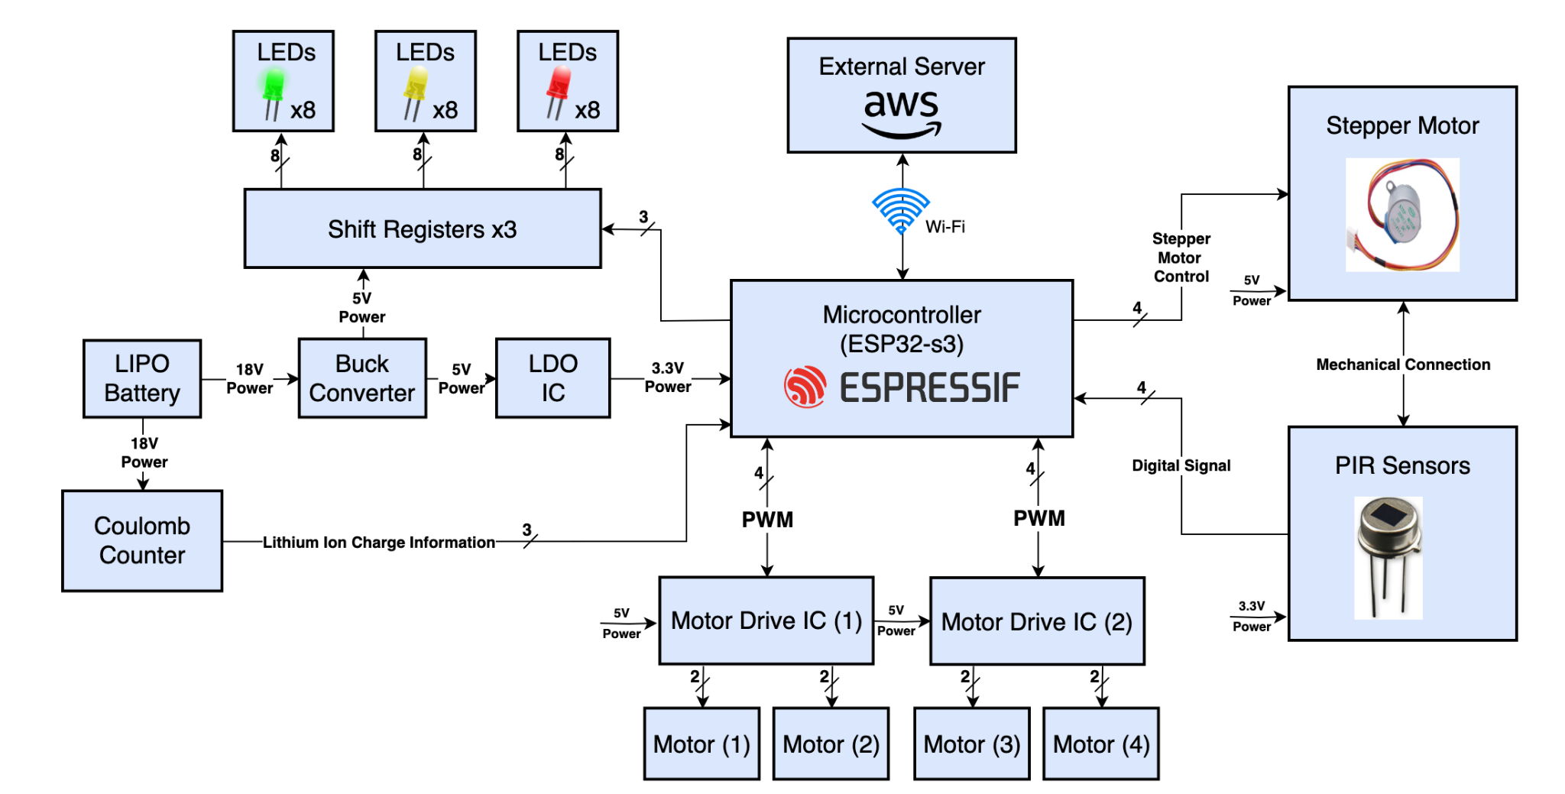
Block Diagram

Slide 6
Design Challenges - Hardware
Finding the best sensors to use for movement detection
Lidar, Ultrasonic, PIR
Researching the correct components and finding PCB footprints
PCB design and assembly for buck converter design from TI Webench
Complex PCB layout required, soldering QFN package
Routing for shift registers on PCB
Moved to protoboard
Reliably powering on the ESP every time MOUSE is powered on
Notes:
In this section, detail major design challenges your team faced in developing your project. These could be conceptual challenges, such as fitting a complex design into a small form factor. Alternatively, these could be implementation challenges, such as difficult hardware and software errors which took many many hours to debug.

Slide 7
Design Challenges - Software
Flashing new ESP32s for WiFi communication
Tuning MOUSE movement controls, particularly turning
Path following through recording and playback
ESP WiFi throughput limitations and minimizing delays
Learning ESP IDF
Notes:
In this section, detail major design challenges your team faced in developing your project. These could be conceptual challenges, such as fitting a complex design into a small form factor. Alternatively, these could be implementation challenges, such as difficult hardware and software errors which took many many hours to debug.

Slide 8
Individual contributions
Matthew Ghera
Software
Microcontroller
WiFi and web socket communication
Shift registers
Controlling DC & stepper motors
PIR Sensor
Web socket
Initialize infrastructure & endpoints
UI
Prototyping
PIR sensor and stepper motor control
CAD/3D printing and package construction
Schematic
Stepper motor control
PCB
LEDs and daisy-chained shift registers
DC and stepper motor control
Coulomb counter
Debugging
Soldering

Slide 9
Individual contributions
Andrew Hall
Prototyping
LEDs and daisy-chained shift registers
Schematic
LEDs and daisy-chained shift registers
DC voltage regulator to go from 18.5V to 5V based on TI Webench design
DC motor drivers
PIR sensors
PCB
DC voltage regulator to go from 18.5V to 5V based on TI Webench design
Debugging
Software
Endpoints for playback status
Mechanical
Package construction
Chassis
Soldering

Slide 10
Individual contributions
Christopher Miotto
Prototyping
Power converter
Motor driver
Schematic
ESP supporting circuitry (USB to ESP, USB to UART)
Buck converter using TI Webench
5V to 3.3V LDO
PCB
Initial layout of all components
Routing GPIO pins to components
ESP supporting circuitry
5V to 3.3V LDO
PIR sensors
Soldering
Debugging
Construction of packaging

Slide 11
Individual contributions
Braden Kirkendall
Software
Frontend endpoints and state recognition
Socket messaging protocol and handling
Backend state detection and error handling
Real-time movement logging for recording/playback
Microcontroller code integration and debugging
Prototyping
Motor drivers PWM control
LED Shift Register Validation
Schematic
Ensured consistency with software initializations and behavior
Mechanical
Assembly of 3D-printed shell
Velcro hatch

Slide 12
Project Demonstration
PSDR #1 (Hardware): An ability to control the speed of the motors with PWM signals from the microcontroller.
PSDR #2 (Hardware): An ability to step down 18.5V from the battery to 5V for circuit components on the PCB and motors using a team designed DC switching regulator.
PSDR #3 (Hardware): An ability to utilize LEDs with a daisy chained shift register circuit controlled by the microcontroller to display battery life diagnostics.
PSDR #4 (Software): An ability to display data, such as movement controls and movement detection data to a viewable UI on a webpage.
PSDR #5 (Software): An ability to control the robot by sending data wirelessly through WiFi via a web server.

Slide 13
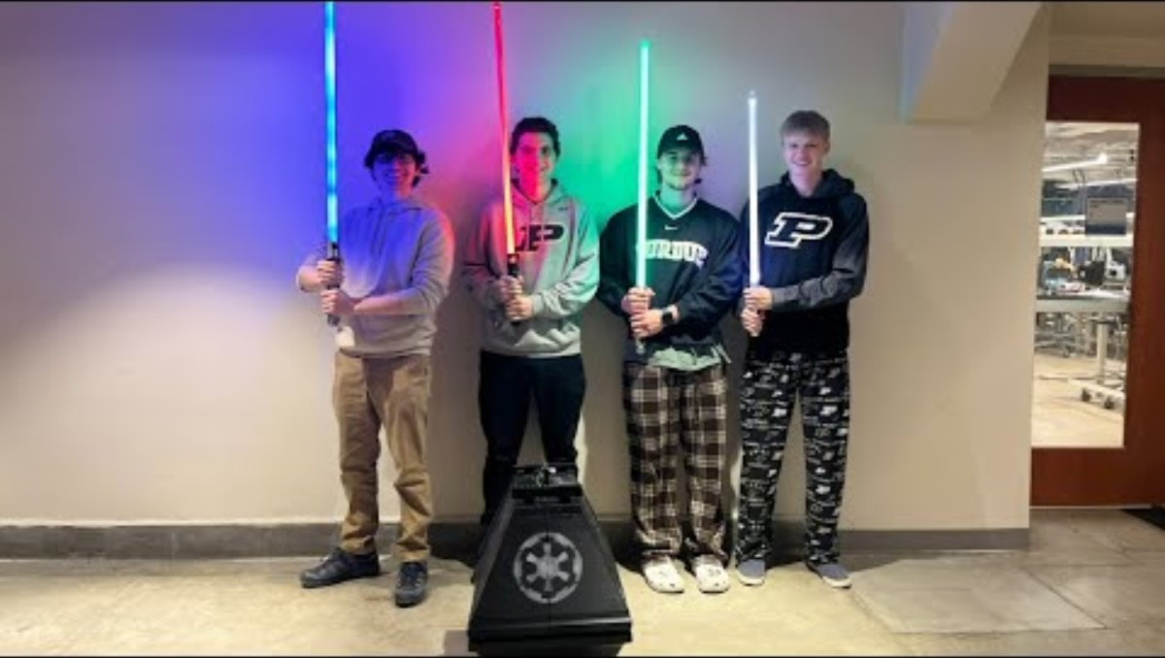

Slide 14
Questions?

